Slide 1
Texas Community Development Block Grant Program
2023 Application Webinar:
Application Guidance & Best Practices for TxCDBG Grants
Notes:
Thanks for joining us this morning! Today we’ll be offering best practices and guidance for applying for 2023 TxCDBG Grants.
A few housekeeping items to start. Please keep your lines muted the entirety of the presentation. We will allow time at the end to answer questions. If you’d like to queue your questions during the presentation, please use the chat feture to pose questions. At the end of the presentation we will answer questions in the chat as well.
Let’s get started!

Slide 2
RFA (Application Guides)
Part I
Part II
Part III
Appendices
Notes:
All of the topics covered in today’s presentation are included the 2023 Request for Applications (RFA) documents, better known as application guides. The past couple years we’ve worked to standardize the formatting of these instructional documents across the programs.
As a result, each Fund category RFA follows the Part 1-3 structure followed by an Appendix.
Part 1 includes fund-specific requirements. So for example, if you’re looking at the DRP guide, this section will look markedly different than the Part 1 for CFC. Topics like fund-specific eligibility and requirements, the NPO for the specific program, maximum award amounts and scoring are covered in these sections. We’re skipping this section today, but should you have any program specific questions please reach out to us via our CDBGApps email.
Today’s presentation focuses on Part 2 & 3, which include general TxCDBG application requirements and general CDBG Federal Requirements. These sections are consistent across the program and apply to each application, regardless of type.
Finally we’ve got the appendices, which include TDA-GO instructions, additional details regarding match documentation, and sample documents.

Slide 3
Topics
Applicant thresholds
Basic eligibility documentation
Project-specific documentation
Jurisdiction of Grant Applicants
Notes:
Here are the main topics of Part 2 and 3 that we’ll cover today.

Slide 4
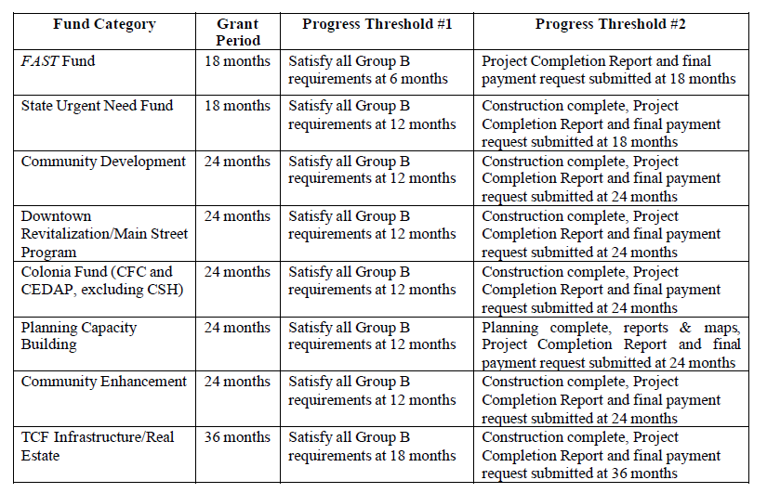
Applicant Thresholds
Notes:
To be eligible to apply for or receive funding under the TxCDBG program, a community must meet applicant thresholds. This table is probably what comes to mind for most when thinking “applicant threshold” – however, these progress thresholds are only one component in a larger group of criteria that an applicant must meet.
Progress thresholds ensure that timely progress is being made on existing grant agreements. Therefore, if a grant applicant does not have an ongoing grant with TxCDBG, these do not apply.
There are two types of Progress Thresholds, each triggered by the number of months from the grant agreement’s start date.
Mid-Point Progress Threshold Requirement (or Progress Threshold #1) – is a rule that, if triggered, requires applicants to submit all Group A and Group B documents for that grant in order to be eligible to submit a new grant application.
Final Progress Threshold Requirement (or Progress Threshold #2) – is a rule that, if triggered, requires the Grant Recipient to complete its TxCDBG project prior to applying for future TxCDBG funding. This threshold has been met, if:
all activities in the TxCDBG agreement Performance Statement (Exhibit A) are complete;
a final payment request for all remaining TxCDBG funds has been submitted in TDA-GO; and
the Project Completion Report (PCR) has been submitted in TDA-GO.
If an applicant has an open TxCDBG grant that has NOT met an applicable progress threshold as of the date the application is due, the application will be disqualified.

Slide 5
Applicant Thresholds, cont.
Administrative capacity
Financial capacity
Project feasibility
Levy and collect tax
Past performance
Single audits
Notes:
Again., progress thresholds are only one component in a larger group of criteria. Here you will see the rest of the criteria to consider.
Administrative capacity – demonstrated ability to manage and administer the proposed project.
This will look different depending on the applicant community’s choices. This is easily demonstrated when a community procures a third-party firm/individual/organization whose personnel are (or will be) TxCDBG Administrator certified. However, some applicants elect to self-administer a grant project which, if awarded, requires completion of the Local Administrative Capacity Form (TDA will reach out requesting this if it applies to your org). In a similar vein, some applicants choose to complete their project via force-account labor/materials/equipment, which requires completion of the A808 request to demonstrate the applicant’s capacity to do so.
Financial capacity – meaning an applicant has demonstrated financial management capacity to sustain operation and maintenances of any improvements made in conjunction with the project. In previous years, this has been primarily demonstrated via the locality’s annual audit as a required submission. BUT, this has been updated. A little more on that in a few slides.
Levy and collect tax – to be eligible for TxCDBG funds, a grant applicant must levy and collect a local property tax and/or a local sales tax option. This is a quick question in the application’s Project Feasibility page.
Past performance of a Grant Applicant’s previous grant agreements with TDA is considered when making a funding determination. An applicant should demonstrate satisfactory performance on previous CDBG projects to be in good standing with the program for future application eligibility. This includes being responsive to the monitoring process and addressing any compliance findings that have been identified.
And Lastly, Single audits – a community must comply with all federal single audit requirements, as described in TxCDBG Implementation Manual, regardless of whether the required compliance is based on received funds other than TxCDBG awards.

Slide 6
Financial Capacity
In Application Process:
The applicant must certify to its capacity and indicate its willingness to adhere to financial management controls included in any resulting grant award.
And If Recommended for Funding
Community must complete a Financial Capacity Self-Assessment to be used by TDA in a risk analysis prior to releasing any grant funds.
Notes:
So back to financial capacity that I mentioned in the previous slide…
In lieu of a copy of the community’s annual audit as required by the Texas Local Government Code:
As part of the application process, the applicant must indicate its willingness to adhere to financial management controls included in any resulting grant award;
AND If recommended for funding, the community must complete a Financial Capacity Self-Assessment to be used by TDA in a risk analysis prior to releasing any grant funds.
If determined to be necessary, conditions may be included in the grant agreement to ensure appropriate financial management capacity. These conditions may be as modest as additional documentation of authority, or as significant as a requirement to allow a third party local government to manage grant funding for high risk communities.

Slide 7
Citizen Participation – At a Glance
Publish/Post public notice of upcoming public hearing
Conduct the public hearing and receive comment
Develop project and complete application
Adopt local resolution authorizing submission of application
Publish/Post public notice of application availability for review
Submit application +5 days after app is available for public review
Notes:
Prior to the preparation and submission of an application for TxCDBG funds, each applicant must hold at least one public hearing and publish a notice that describes the application activities and the availability of the application(s) for public review. This is the timeline and order for the required steps of this process.

Slide 8
Public Notices
Public Notice methods:
Publish notice in a newspaper of general circulation
Post notice in at least two public places
Must include courthouse/city hall and a location within the benefit area (if applicable)
Post notice in one public place AND publish on the Grant Applicant’s website
Notes:
Public notice can be provided the following ways. These requirements have been updated to be consistent with Chapter 1 of the implementation manual. These requirement apply to both notices required in the application process.

Slide 9
Documentation of Notice
Public notice documentation:
Copy of the published notice in the newspaper AND a publisher’s affidavit.
Photos of the notice posted at the location(s) AND an affidavit of posting.
Screenshot of the website with date and URL visible AND affidavit of posting.
Notes:
Compliance with these requirements can be demonstrated by providing [list]

Slide 10
Public Hearing
TDA recommends conducting one public hearing per year.
Earliest Date for PY 2023: September 1, 2022
Hearing must address the following topics:
The development of housing and community development needs;
The anticipated funding opportunities addressing these needs;
All eligible activities under the Texas Community Development Block Grant Program;
Notes:
Now for the public hearing itself… TDA recommends conducting one public hearing per year to address current needs and identify potential future funding opportunities.
For all TxCDBG grant applications for PY 2023 a public hearing conducted on or after September 2022 will be accepted, unless the hearing notice limited the topic of discussion to specific fund categories.
The topics of discussion should, at a minimum include:
The development of housing and community development needs, including
o current supply of affordable housing and past efforts to increase supply,
o current social services available to residents and what needs and/or populations remain underserved, and
o current condition of public infrastructure and efforts to improve these conditions;
The hearing should also cover anticipated funding opportunities for which the needs identified through this process may be considered and all eligible activities under the TxCDBG, including the applicant’s use of past TxCDBG grant funds, if applicable.

Slide 11
Application Resolution
The language of the resolution must, at a minimum:
Authorize the submission of an application for funding under the TxCDBG
Designate the fund category applied under;
Designate the activities addressed in the application;
Designate the dollar amount being requested;
Commit to the provision of resources by source and use (if applicable)
Commit to compliance with all federal, state, and program requirements
Notes:
TxCDBG applications require a resolution from the local governing body (i.e., County Commissioners Court or City Council) authorizing the submission of that application. The governing body must adopt/pass the resolution before the application submission and after the application public hearing. Failure to comply with this resolution requirement may result in disqualification of the application. Remember that this document should [list]
Remember, the adoption of this resolution is required for every application submission, not one per year (like the public hearing option).

Slide 12
Signatory Resolution
The language of the resolution must, at a minimum:
Designate those authorized to execute documents in conjunction with the application, and any resulting grant agreement.
Designate those authorized to execute financial documents, including payment requests.
Only those person(s) and/or position(s) named in the resolution will be permitted to take action in TDA-GO on behalf of the community.
Upload this resolution to the Organization Profile.
Notes:
New for this cycle is a separate Signatory resolution.
This resolution designates the person or positions that are authorized to execute or certify documents as an Authorized Official, Project Director, or Payment Processor.
Once the Signatory Resolution is adopted and submitted to TDA-GO, the community may continue to rely on the same resolution for subsequent TxCDBG applications. The community may provide an updated resolution at any time as local needs change.

Slide 13
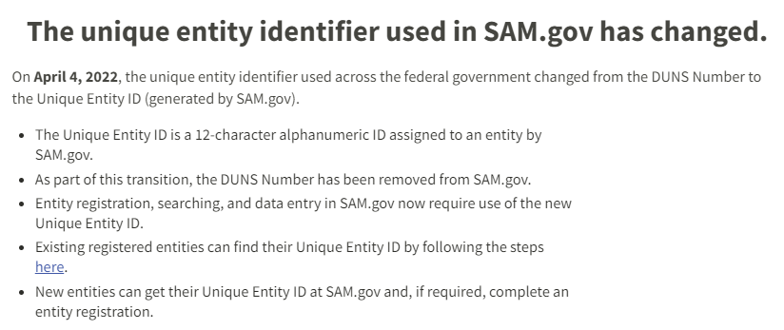
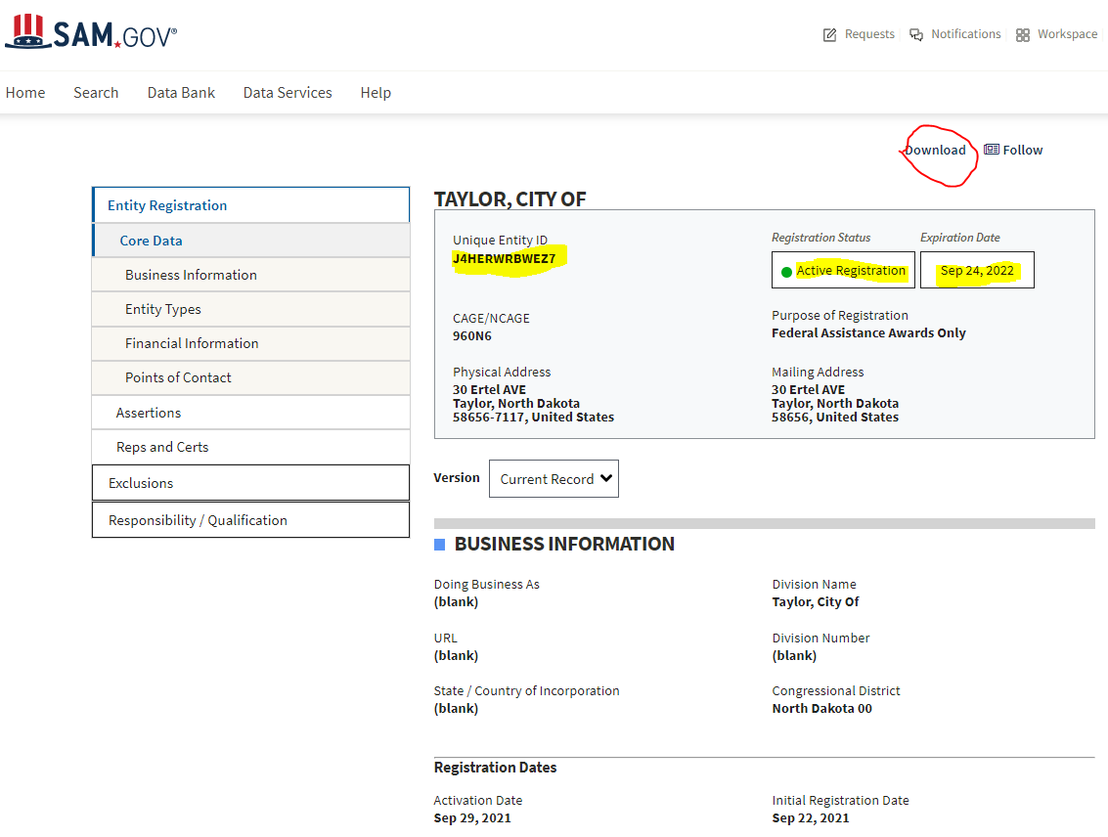
System of Award Management (SAM.gov)
Notes:
TxCDBG applicants must demonstrate an active registration in the System for Award Management (SAM) to be eligible for funding. The applicant should upload a screen-shot from the SAM to verify the entity’s registration is active. Without evidence of an active SAM registration, the application is ineligible to receive HUD funds and will be disqualified.
One update to note is that SAM.gov no longer users DUNS numbers as part of the registry. Each entity is now assigned a 12-character Unique Entity ID (UEID). Make sure the UEID on the registration page matches your entity AND the organization’s profile in TDA-GO.

Slide 14
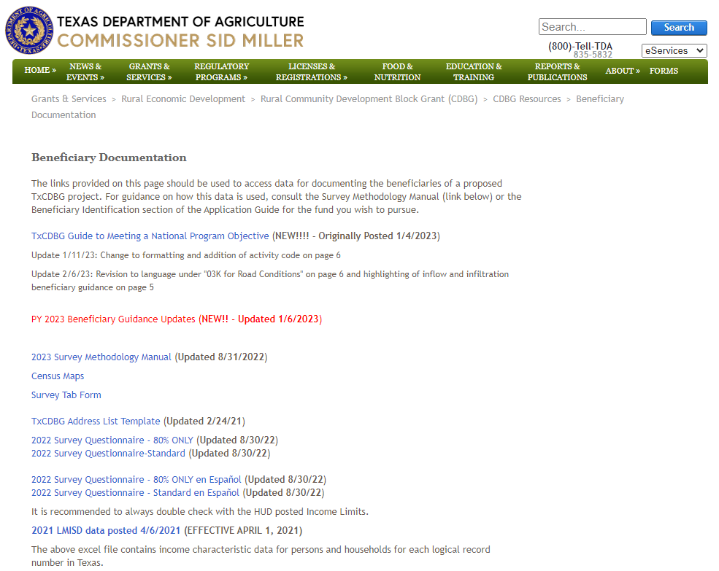
Project-Based: Beneficiary Documentation
TxCDBG Guide to Meeting a National Program Objective
TxCDBG Survey Methodology
Expect updated TxCDBG questionnaires and 2023 LMISD data
Notes:
We’re going to breeze over this topic, but that doesn’t mean it isn’t important. Rather, documentation of a project’s satisfaction of a National Program Objective is critical to an application’s eligibility! It’s so important that we’ve dedicated quite a few resources to this topic alone. Please see the [list] for specific guidance regarding beneficiary documentation. These publications and any updates to them can be found online.

Slide 15
Project-Based: Maps
The following information on the same map:
The boundaries of the applicant’s jurisdiction;
Location(s) of the benefit area(s); and
Location(s) of all proposed project activities
sewer/water lines, lift stations, street pavement, water storage tanks, water wells, wastewater treatment plants, public facility improvements, etc.
Legible Street Names
Notes:
Project maps are essential in communicating the who, what, where of a proposed project. An ideal project map should include this information and sometimes more, depending on the complexity of the project and system.
At a minimum (list)
It is not necessary to show linear footage or other construction details on the map itself.

Slide 16
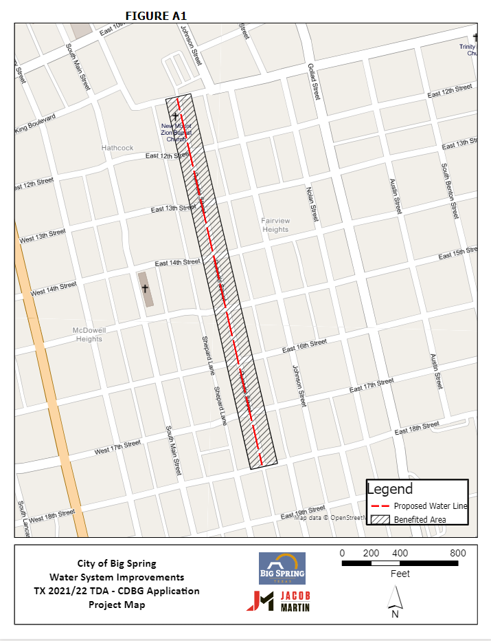
Project-Based:
Maps Example
Notes:
Here is an example of a high quality project map that communicates necessary information
Hrere you can see the BA, project activities, and Street Names are clearly denoted

Slide 17
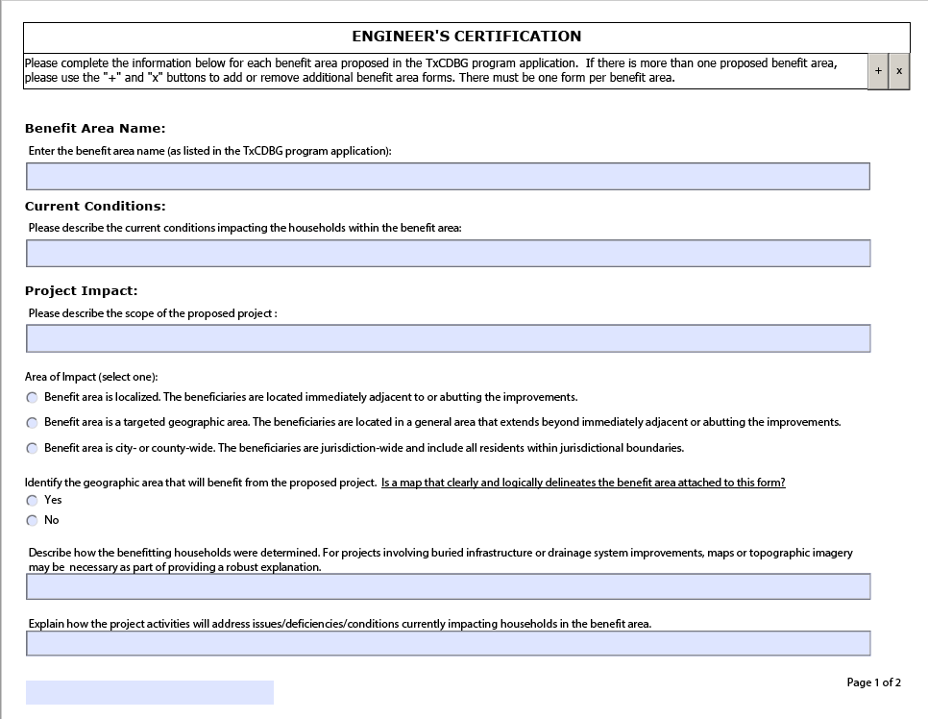
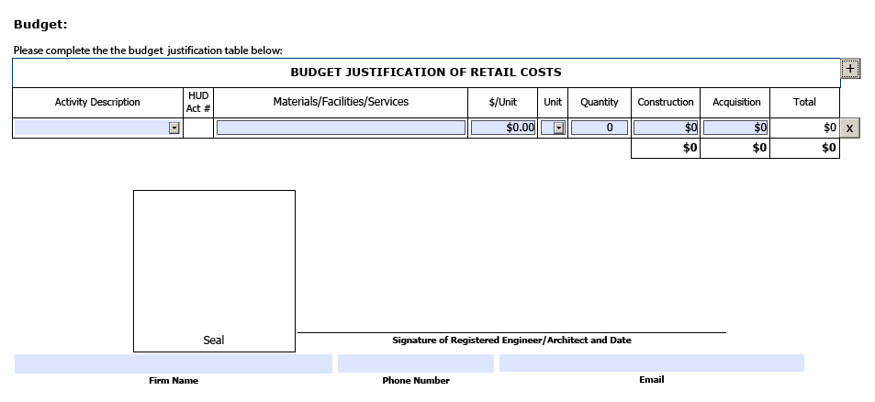
Project-Based:
Engineer’s Certification
For infrastructure construction projects, project engineer must fully complete the Engineer Certification form.
Notes:
The Engineer Certification Form.
This is an important element because the applicant, with the advice of the project engineer, is responsible for identifying the benefit area based on appropriate criteria that is independent of income documentation.
This form also serves as the basis for the reasonable cost estimate on which the grant request is based.

Slide 18
Project-Based: Agreements
If the service provider for the project is an outside entity that will own or operate the proposed improvements
(water supply corporation, locality providing service to the project area, etc.)
TDA will request a cooperative agreement outline the responsibilities between the applicant and the partnering entity or entities, upon award.
Notes:
If an application involves a service provider that is NOT the Grant Applicant, TDA will request a cooperative agreement between both parties. This isn’t required by application submission (rather, by award if funded), but should be considered when brainstorming project scope.

Slide 19
Jurisdictional Considerations
If only a portion of the project’s beneficiaries are located within an applicant’s jurisdiction, applicant must partner with another eligible local government that has jurisdiction in that area.
Separate public hearings
Interlocal agreement
All participating jurisdictions must be eligible
Benefit area is not (always) determined by jurisdictional boundaries
Partnering with an applicant will not prevent submission of separate, unrelated application within same round of funding, so long as:
Project does not serve same benefit area; and
Project is not located in same physical location
Notes:
Project beneficiaries must reside within an applicant’s jurisdiction. If only a portion of the project’s beneficiaries are located within an applicant’s jurisdiction, applicant must partner with another eligible local government that has jurisdiction: These jurisdictions would both
Have Separate public hearings
Enter into an Interlocal agreement
All participating jurisdictions must be eligible
Benefit area is not (always) determined by jurisdictional boundaries
Partnering with an applicant will not prevent submission of separate, unrelated application within same round of funding, so long as:
Project does not serve same benefit area; and
Project is not located in same physical location
Instead, the partnership establishes the need and community support for the project and the authority to carry out the project impacting each jurisdiction.

Slide 20
Planning as a CDV Activity
Planning activities can be requested in the CDV application as a separate activity:
Related Planning Activities - system mapping, system analysis and inventory of current conditions, and a capital needs priority list for the same activity type for which construction is proposed.
Comprehensive Planning Activities - base mapping, land use analysis, housing and population analysis, and financial analysis for capital improvements for at least three planning elements.
Notes:
One item that is Fund specific we do want to mention since it is new. Beginning this year, planning will not have a separate grant cycle, but is available within the Community Development Fund application. Each application allows up to 6 separate activities – to requesting funding for planning services, you will create a separate activity using activity code 20 or 20A.
There are two types of planning activities.
Related Planning allows for system wide planning for the same utility or system that is being proposed for improvements in the application. The related planning is not project specific, but planning for the future needs of the system with the proposed improvements in place.
Comprehensive Planning is the more traditional community-wide planning that encompasses multiple systems and community needs.

Slide 21
Reminder: Complete Applications
Changes cannot be made to applications after the Due Date
Notes:
After the application due date, communities can not change the proposed project or replace the information that was already submitted. Communities can ask questions or clarify but can not make changes.
Before we open the lines for questions, one brief announcement about the Community Development or CD Fund.. The current deadline for the CD Fund is April 3,2023. We’ve mentioned previously the possibility of a 30-day application deadline extension. We will be deciding this week as to whether the deadline will be extended.

Slide 22
Questions?
CDBGApps@TexasAgriculture.gov

